Slide 1



In-Depth with Local SEO
O’Reilly Where, April 4th, 2012
Rand Fishkin | CEO
http://bit.ly/mozlocalseo2012

Slide 2
What is “Local” SEO

Slide 3
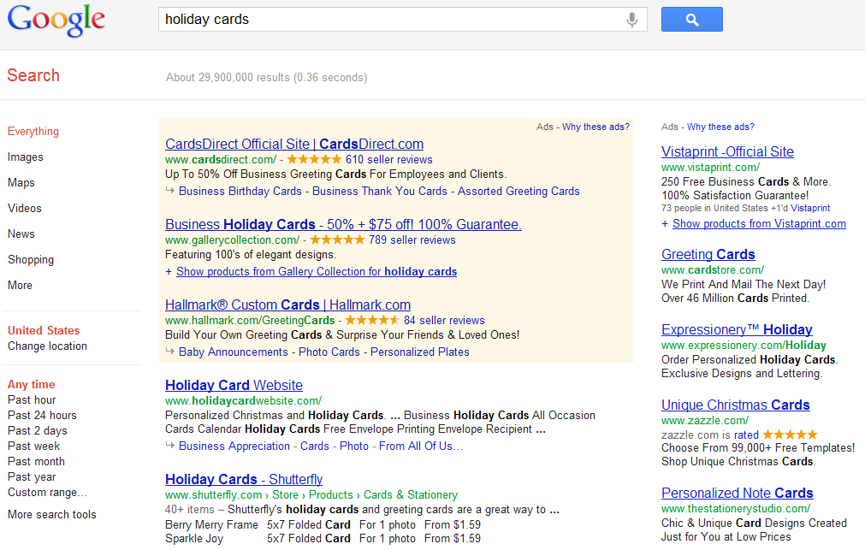

PPC/SEM
Regular SEO

Slide 4
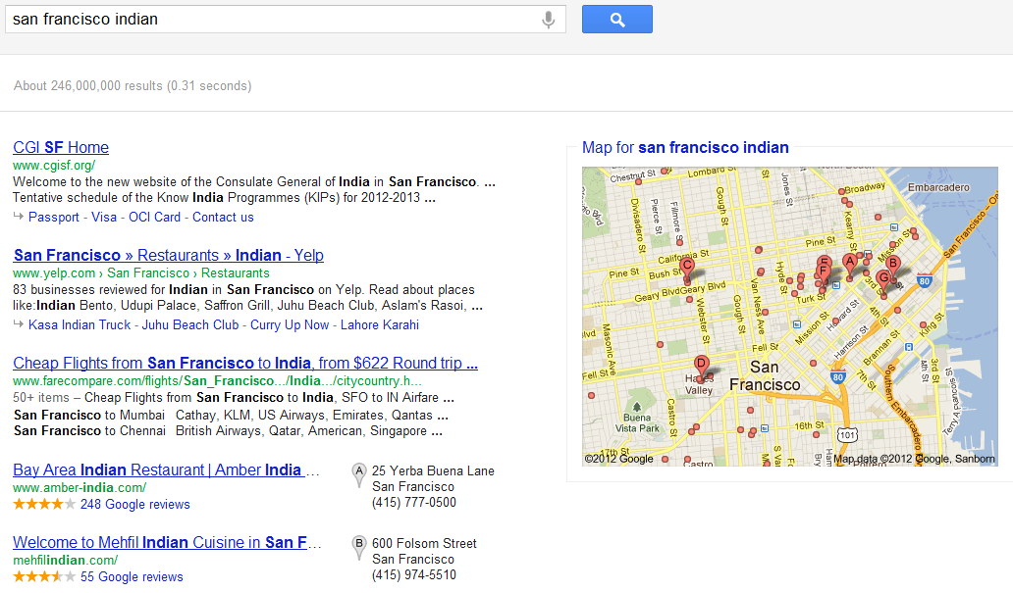
Regular SEO
Local SEO

Slide 5
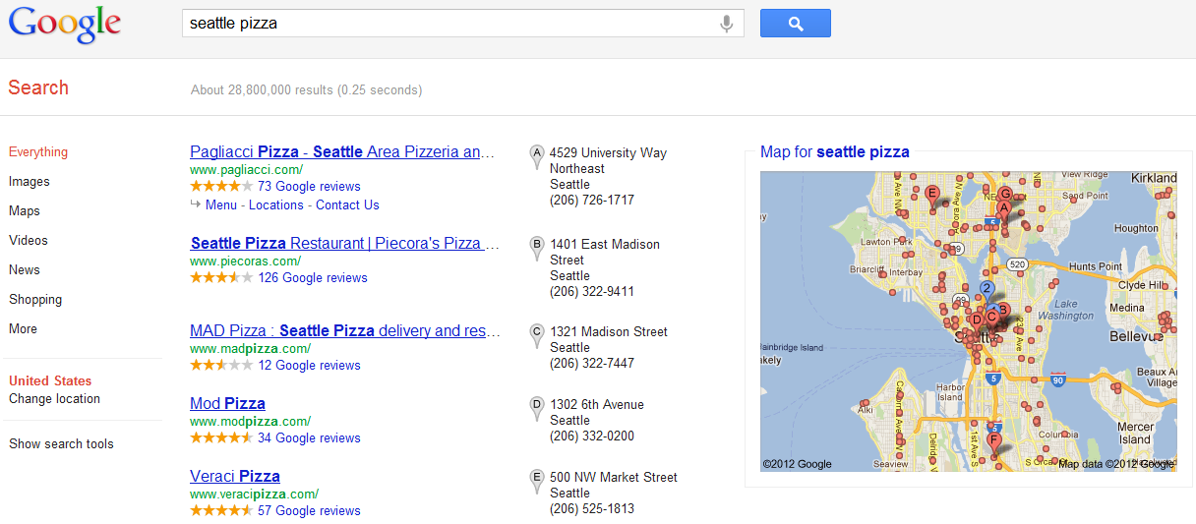
Local SEO

Slide 6
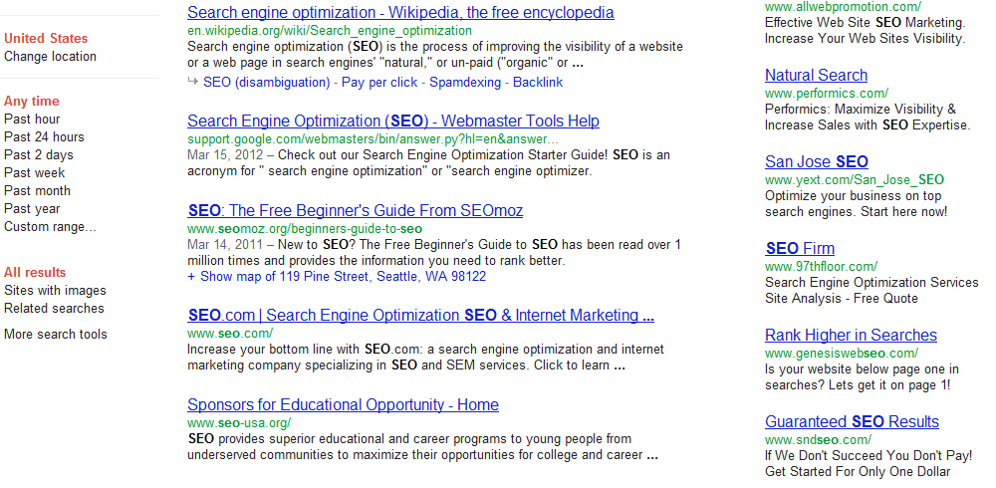
Location Often Impacts Results

Slide 7
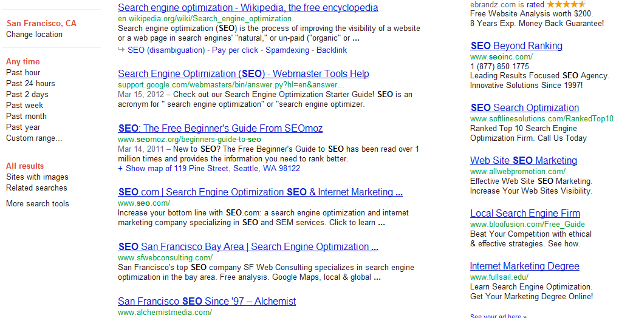
Specific Location
(which Google often auto-detects)
Location-Biased Results

Slide 8
Local SEO Defined
The practice of improving the quantity and quality of traffic from search queries with a geographic intent.
This broad definition doesn’t restrict Local SEO to Google + Bing or to only maps-style queries.

Slide 9
The Local SEO Process

Slide 10
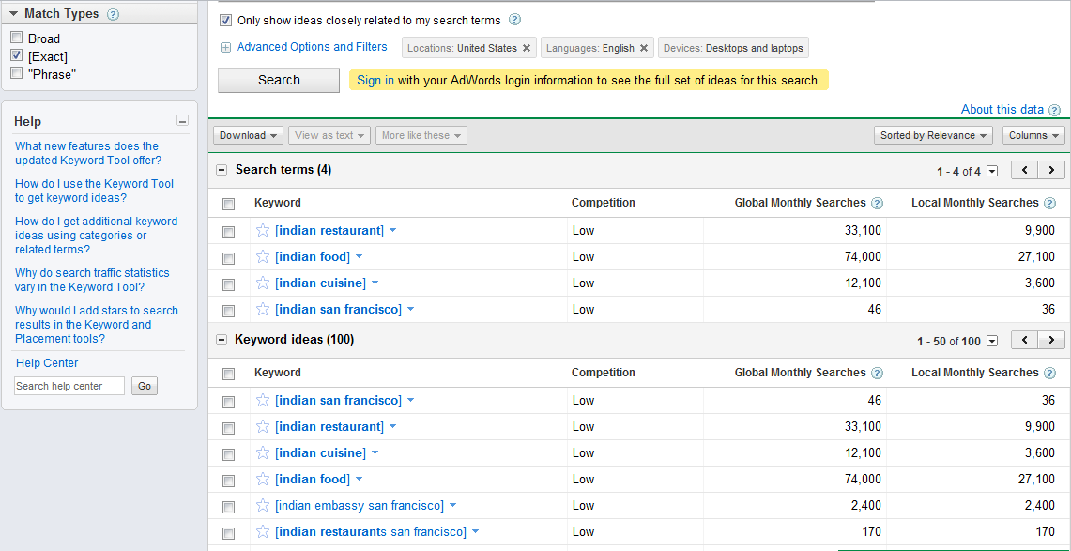
Conduct Basic Keyword Research
Watch exact vs. broad carefully
Via Google’s Adwords Keyword Research Tool

Slide 11
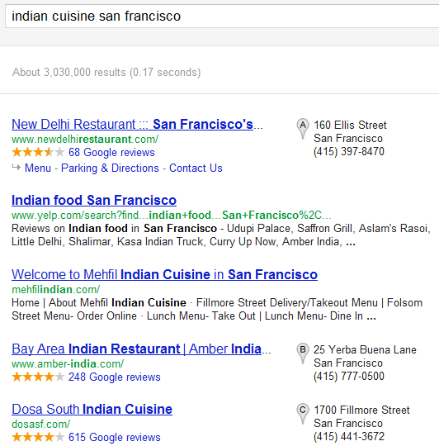
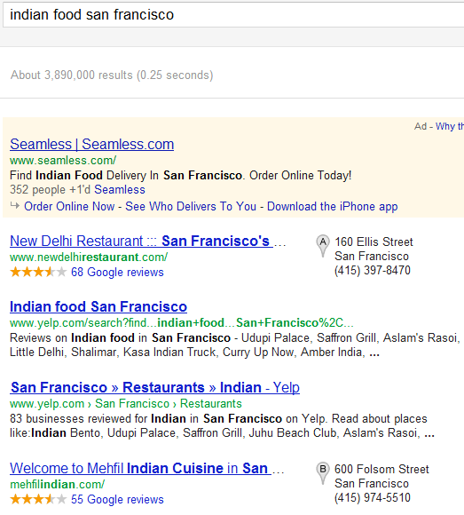
Investigate the Search Results
Note where & how maps results vs. standard results appear
This can help inform which results to pursue with which tactics.

Slide 12
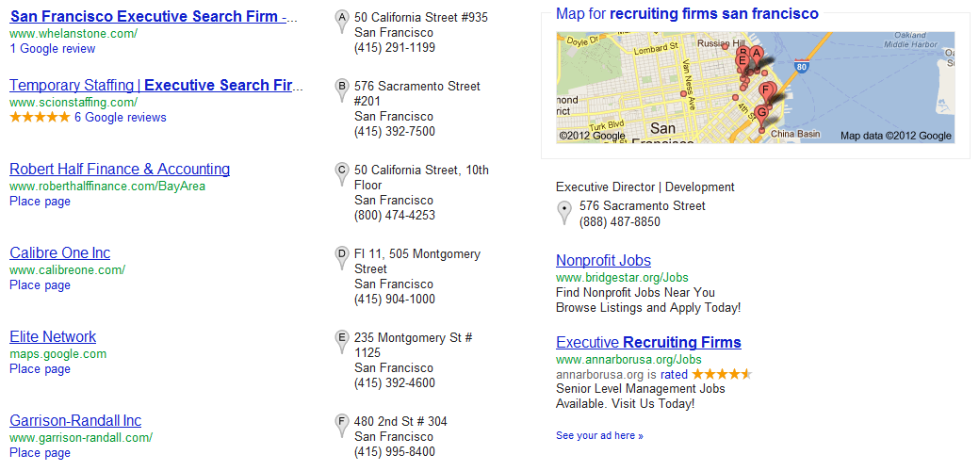
Evaluate Keyword Competition
This result set is clearly very non-competitive. There’s few reviews or even serious data for most of the listings.

Slide 13
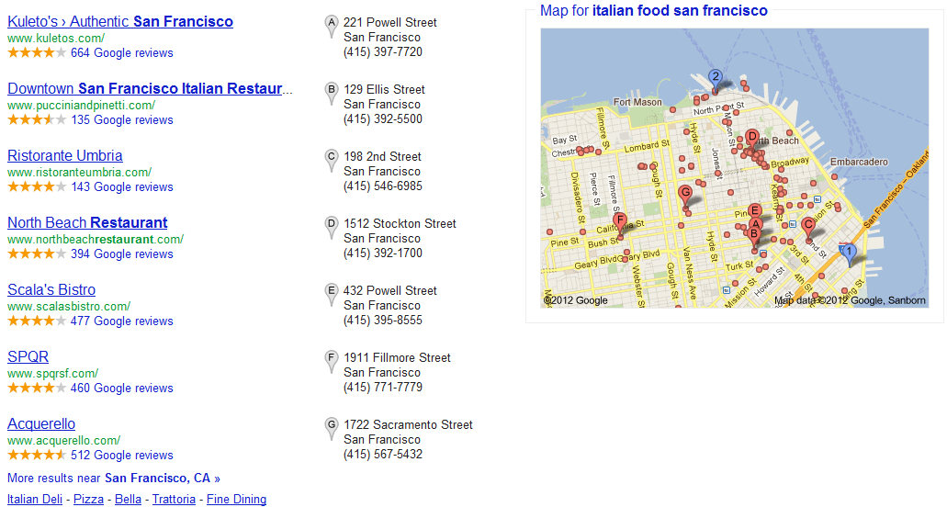
Evaluate Keyword Competition
This set is the opposite. Everyone listed has hundreds of reviews and tons of information; very competitive to rank here.

Slide 14
Make Smart Keyword Targeting Choices
High Volume
(many searches/month)
Low Competition
(weak sites/pages in the top 10)
Ideal Keywords!
High Value
(large % of visitors convert)
Those terms & phrases that bring you high quality customers but aren’t tremendously competitive will be the best place to start. Over time, you can and should pursue more challenging terms.

Slide 15
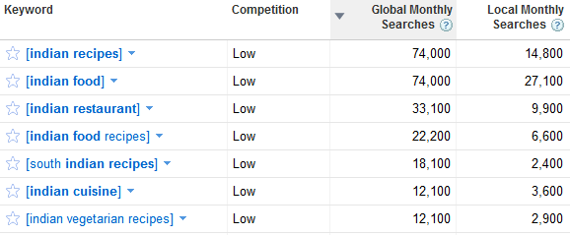
Website & Content Planning
Homepage
Recipes Page
Menu/Cuisine Page
In planning the website, you need to determine which pages have been built and need to target keywords and which still need to be created to target new terms/phrases

Slide 16

Be Creative with Content Whenever Possible
http://thisismadebyhand.com/film/the_knife_maker

Slide 17
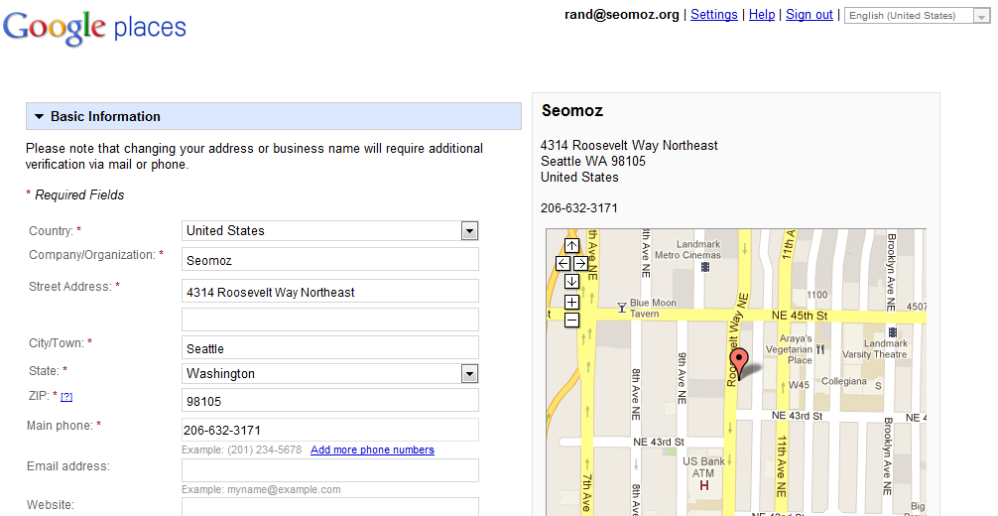
Claim/Clean Structured Citations
List of Local Directories: http://blog.hubspot.com/blog/tabid/6307/bid/10322/The-Ultimate-List-50-Local-Business-Directories.aspx

Slide 18
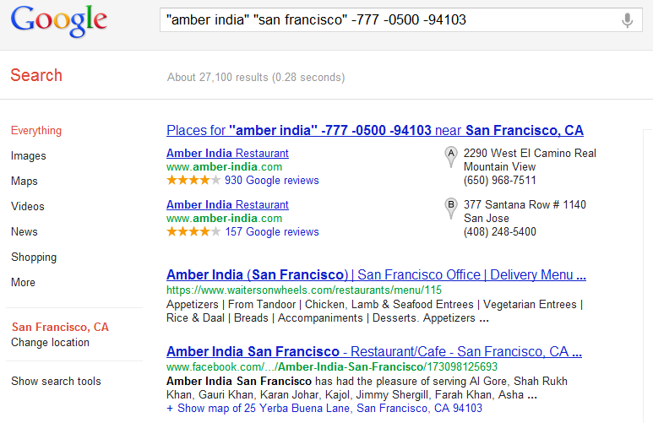
Create/Clean Unstructured Citations
These listings don’t include the correct phone number and should be updated
Example Search Query Structure: http://www.google.com/search?q=“business+name”+”city”-zipcode

Slide 19
Best Practices for Local SEO

Slide 20
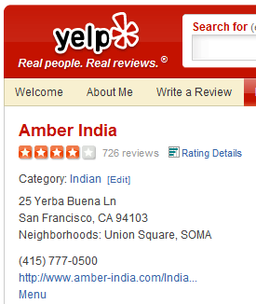
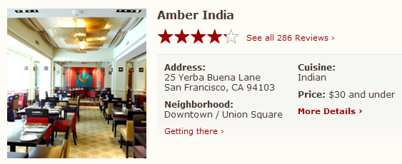
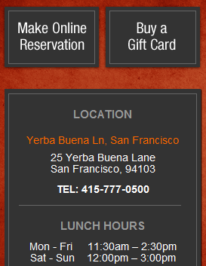
Accurate Data Across Every Listing Source
Yelp, OpenTable, Amber’s website, Google Local, etc. should all have exactly the same details.
Test

Slide 21
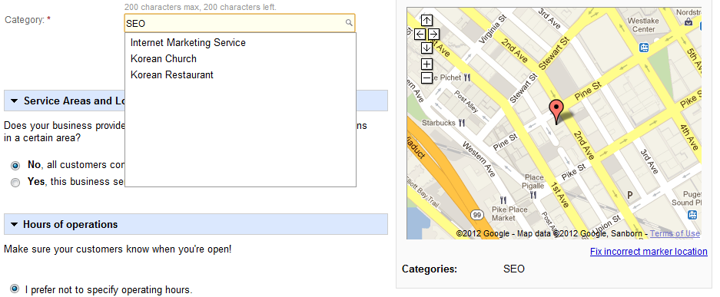
Strategic Selection of Listing Categories
Great tool to help: http://blumenthals.com/index.php?Google_LBC_Categories. And an excellent blog post on the topic: http://www.visonthenet.com/selecting-the-most-profitable-categories-for-your-local-business-listing-1785.html

Slide 22
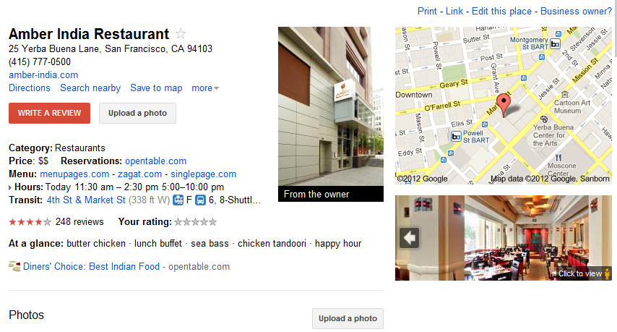
Completeness & Quality of Listings
For each listing, it pays to manually provide the maximum amount of depth + detail possible.

Slide 23
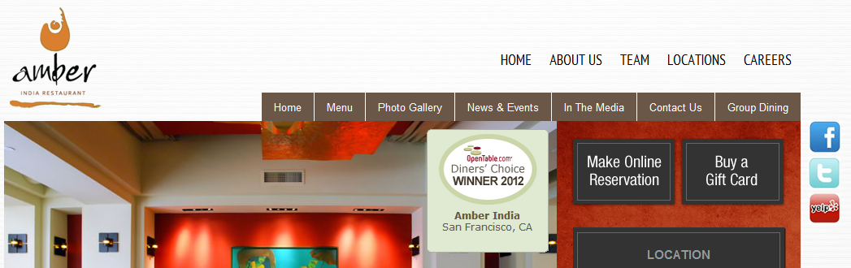
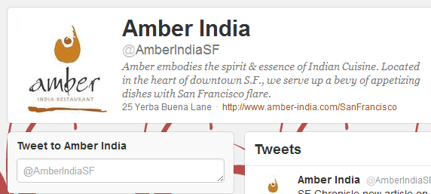
Connection of Listings, Social Profiles & Website
Smart move from Amber – linking to their social profiles and including their address info on those pages, too!
Twitter, Facebook, Google+, FourSquare, CitySearch, Google Local, Yelp, UrbanSpoon and LinkedIn should all be claimed (at least).

Slide 24
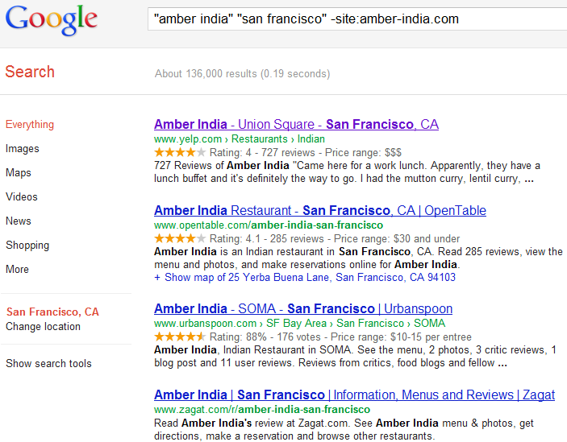
Focus on Citation & Recommendation Growth
136K results! Excellent work.
PRO Tip: Use searches like this on your competition to find all the places you can potentially get a citation.

Slide 25
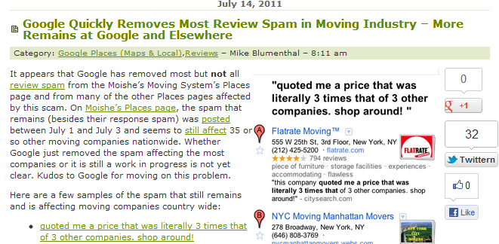
Be Careful About Manipulating Reviews
Google, Yelp and all the major providers work hard to prevent manipulative/spammy reviews from showing up in the results.

Slide 26
Helpful Tools for Local SEO

Slide 27
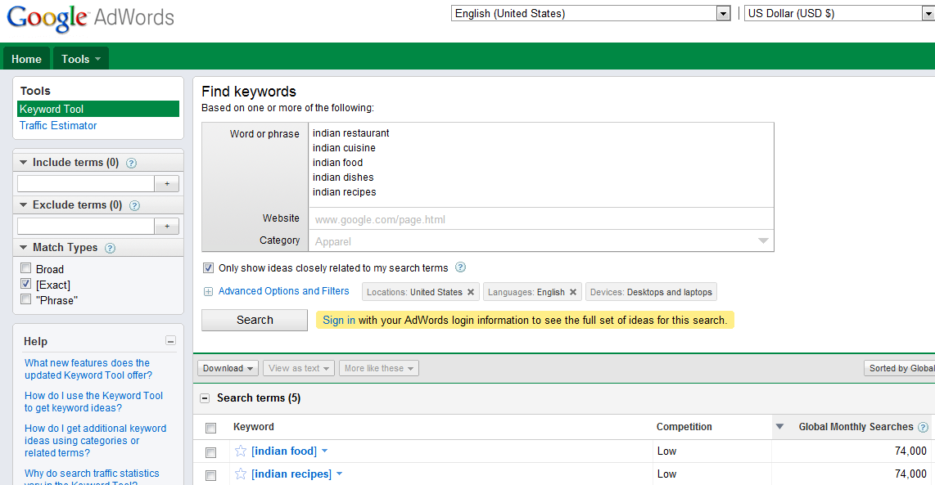
Google AdWords Keyword Tool
https://adwords.google.com/select/KeywordToolExternal

Slide 28
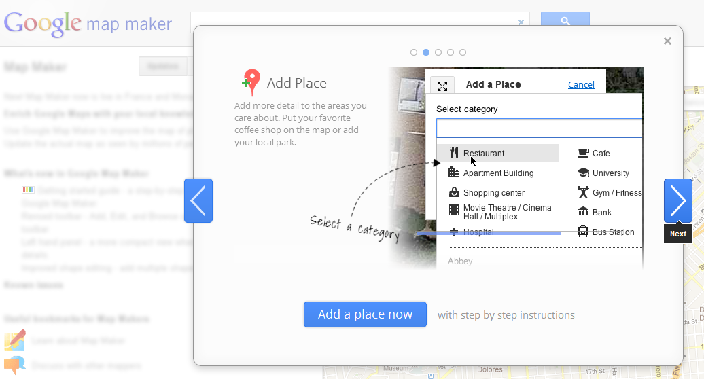
Google MapMaker
http://www.google.com/mapmaker

Slide 29
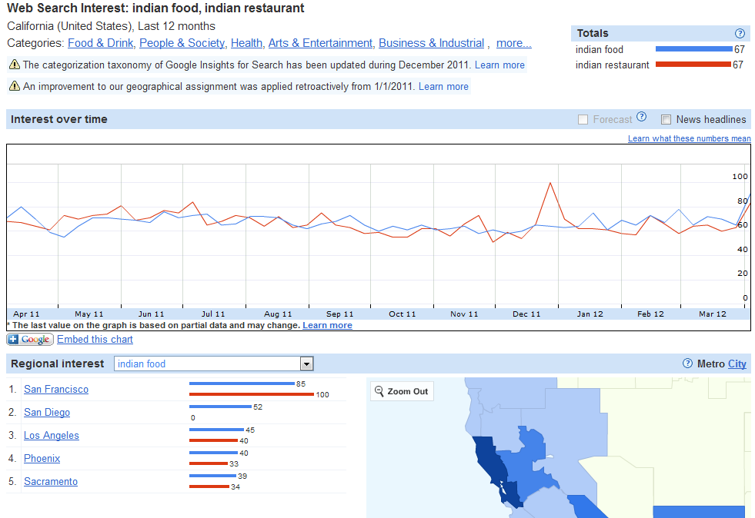
Google Insights Geo Drill-Down
http://www.google.com/insights/search

Slide 30
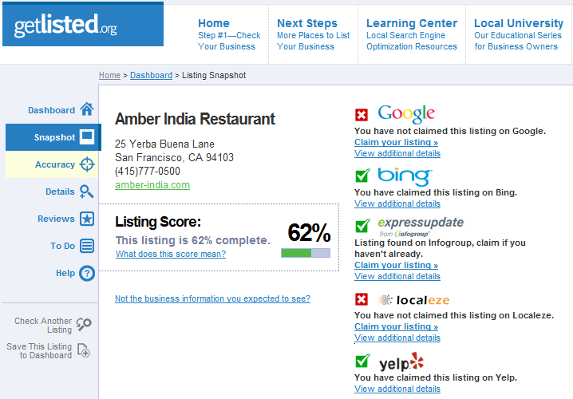
GetListed.org Verification Tool
http://getlisted.org/

Slide 31
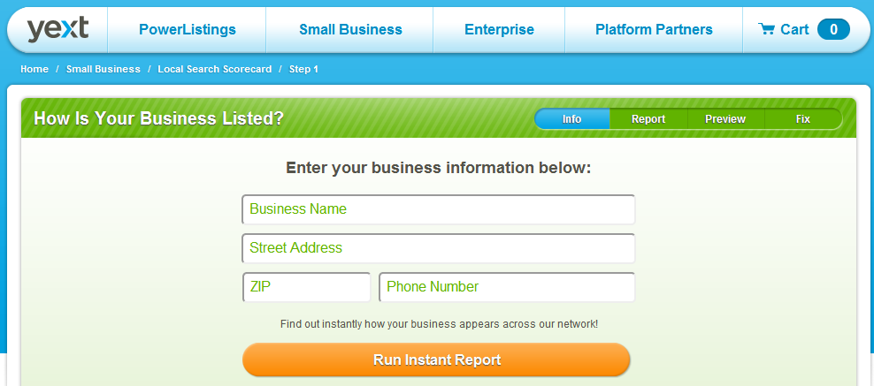
Yext Local Search Scorecard
http://www.yext.com/diagnostic.html

Slide 32
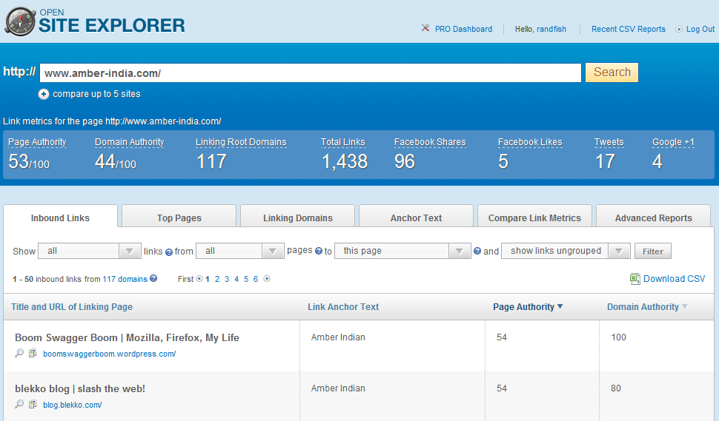
OpenSiteExplorer Link Analysis
http://www.opensiteexplorer.org

Slide 33
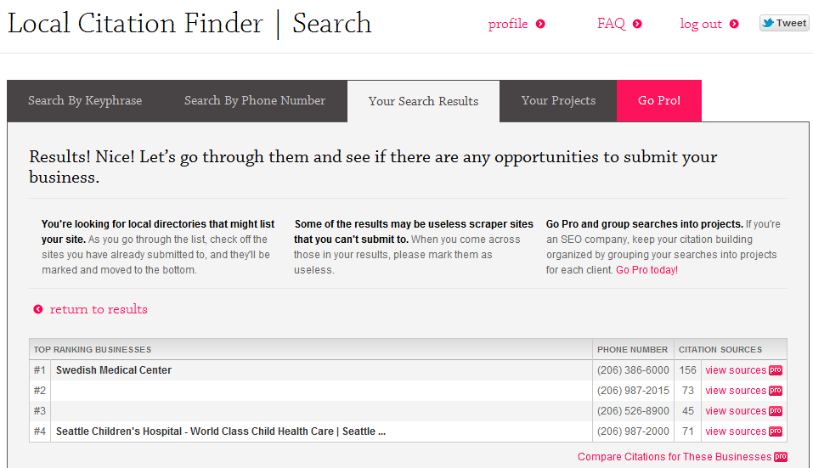
Whitespark Local Citation Tool
http://www.whitespark.ca/local-citation-finder

Slide 34
Recommended
Local SEO Resources

Slide 35
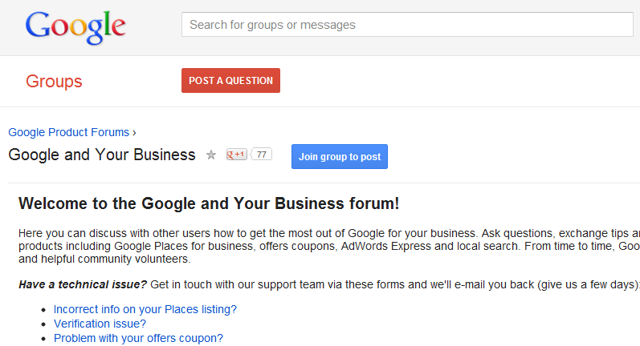
Google Places Help Forum
http://groups.google.com/a/googleproductforums.com/forum/#!forum/business

Slide 36
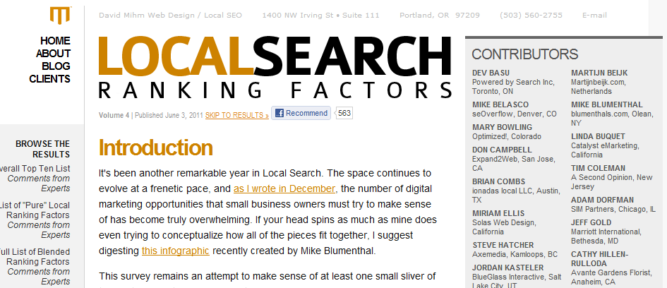
Local Search Ranking Factors
http://www.davidmihm.com/local-search-ranking-factors.shtml

Slide 37
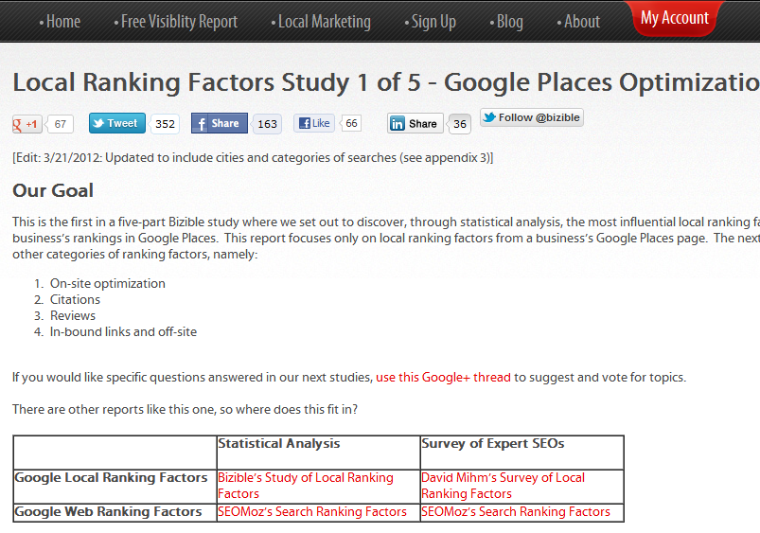
Local SEO Ranking Correlations
http://bizible.com/local-search-ranking-factors/google-places-optimization

Slide 38
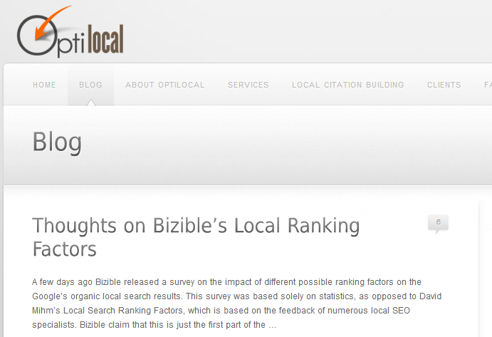
OptiLocal Blog
http://www.optilocal.org/blog/

Slide 39
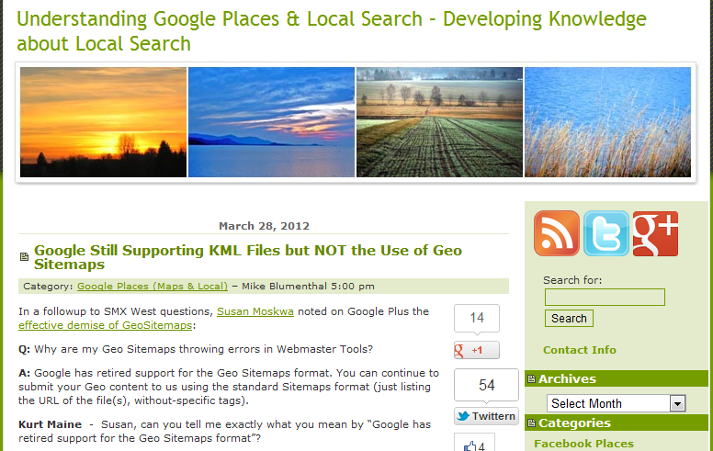
Mike Blumenthal’s Blog
http://blumenthals.com/blog/

Slide 40
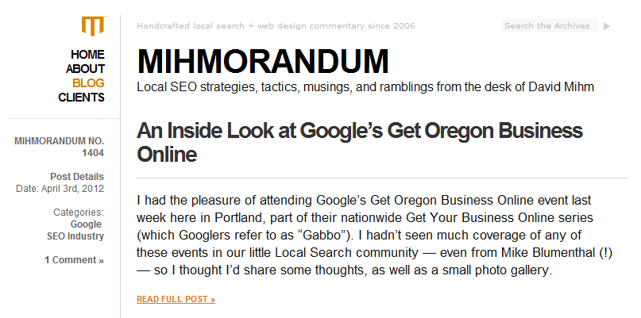
David Mihm’s Local SEO Blog
http://www.davidmihm.com/blog/

Slide 41
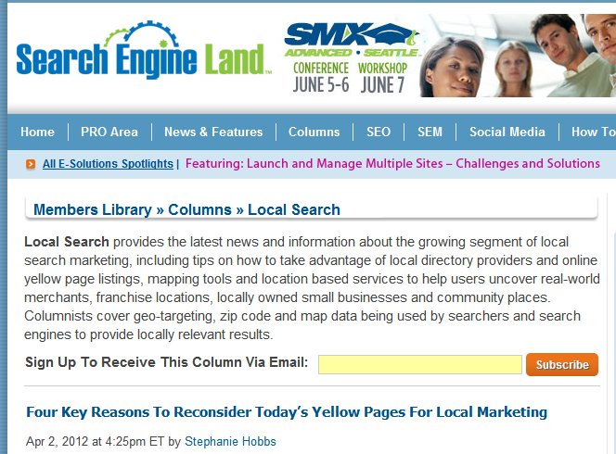
SearchEngineLand’s Local SEO Column
http://searchengineland.com/library/local-search/

Slide 42




Rand Fishkin | CEO
@randfish
www.seomoz.org/blog
rand@seomoz.org
http://bit.ly/mozlocalseo2012

